Slide 1


Luu Vi
25 February 2025

Slide 2

Outline
Executive Summary
Introduction
Methodology
Results
Conclusion
Appendix

Slide 3
Executive Summary
In this capstone project, we will use various machine learning classification algorithms to predict whether the SpaceX Falcon 9 first stage will land successfully. The key steps in this project are:
Data Collection, Wrangling, and Formatting
Exploratory Data Analysis
Interactive Data Visualization
Machine Learning Prediction
Our analysis reveals that certain features of the rocket launches are correlated with the success or failure of the landings. Based on the findings, we conclude that the decision tree algorithm might be the most effective machine learning model for predicting whether the Falcon 9 first stage will land successfully.

Slide 4
Introduction
In this capstone project, the goal is to predict whether the first stage of a Falcon 9 rocket will land successfully. SpaceX lists the cost of a Falcon 9 launch at $62 million, significantly lower than other providers, whose launches start at over $165 million. A major factor in this cost difference is SpaceX’s ability to reuse the first stage. By predicting whether the first stage will land, we can estimate the cost of the launch. This information can be valuable for other companies bidding against SpaceX for rocket launch contracts.
It’s important to note that most unsuccessful landings are planned events. Occasionally, SpaceX may carry out a controlled landing in the ocean.
The primary question we aim to answer is: given a set of features, such as payload mass, orbit type, launch site, and more, can we predict whether the first stage of the Falcon 9 rocket will land successfully?

Slide 5

Section 1

Slide 6
Methodology
Executive Summary
Data collection methodology:
Data was collected using SpaceX API and web scraping from Wikipedia.
Perform data wrangling
One-hot encoding was applied to categorical features
Standard scaler was applied to numerical features for normalization
Perform exploratory data analysis (EDA) using visualization and SQL
Perform interactive visual analytics using Folium and Plotly Dash
Perform predictive analysis using classification models
Logistic regression
Support vector machine (SVM)
Decision tree
K-nearest neighbors (KNN)

Slide 7
Data Collection
Data Collection Process:
SpaceX API Data Retrieval:
Data was collected using a GET request to the SpaceX API.
The response content was decoded as JSON using the .json() function.
The JSON data was converted into a pandas dataframe using .json_normalize().
Data Cleaning:
The dataset was cleaned by checking for missing values.
Missing values were filled in as needed.
Web Scraping:
Web scraping was performed on Wikipedia for Falcon 9 launch records using BeautifulSoup.
The objective was to extract the launch records from an HTML table.
The table was parsed and converted into a pandas dataframe for future analysis.

Slide 8
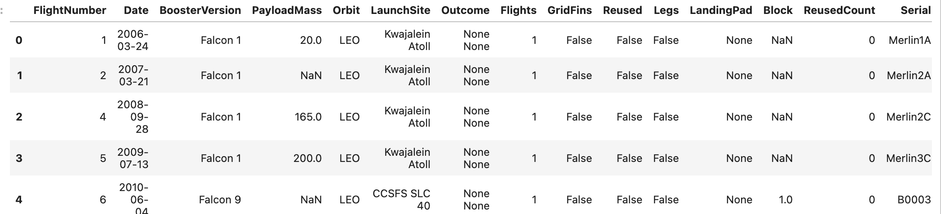
Data Collection
SpaceX API:
API Used: https://api.spacexdata.com/v4/rockets/
The API provides data on various SpaceX rocket launches.
The data is filtered to focus only on Falcon 9 launches.
Missing values are filled with the mean of the respective column.
The dataset consists of:
90 instances (rows)
17 features (columns)
The image below shows the first few rows of the data.
Github https://github.com/LuuVi2911/IBM-Data-Science-Capstone/blob/main/%5B1%5Djupyter-labs-spacex-data-collection-api-v2.ipynb

Slide 9
Data Collection – SpaceX API
SpaceX API:
API Used: https://api.spacexdata.com/v4/rockets/
The API provides data on various SpaceX rocket launches.
The data is filtered to focus only on Falcon 9 launches.
Missing values are filled with the mean of the respective column.
The dataset consists of:
90 instances (rows)
17 features (columns)
The image below shows the first few rows of the data.
Github https://github.com/LuuVi2911/IBM-Data-Science-Capstone/blob/main/%5B1%5Djupyter-labs-spacex-data-collection-api-v2.ipynb

Slide 10

Data Collection - Scraping
Web Scraping:
Source: Data was scraped from Wikipedia - Falcon 9 Launches
The website contains data only about Falcon 9 launches.
The dataset consists of:
121 instances (rows)
11 features (columns)
The image below shows the first few rows of the data.
Github
https://github.com/LuuVi2911/IBM-Data-Science-Capstone/blob/main/%5B2%5Djupyter-labs-webscraping.ipynb

Slide 11

Data Wrangling
The data is later processed so that there are no missing entries and categorical features are encoded using one-hot encoding.
An extra column called ‘Class’ is also added to the data frame. The column ‘Class’ contains 0 if a given launch is failed and 1 if it is successful.
In the end, we end up with 90 rows or instances and 83 columns or features.
Github: https://github.com/LuuVi2911/IBM-Data-Science-Capstone/blob/main/%5B3%5Dlabs-jupyter-spacex-Data%20wrangling-v2.ipynb

Slide 12



EDA with SQL
Pandas and NumPy:
Functions from Pandas and NumPy were used to derive basic information about the data, including:
Number of launches at each launch site.
Occurrence of each orbit type.
Frequency of each mission outcome.
SQL:
SQL queries were used to answer key questions, such as:
The names of unique launch sites in the space mission dataset.
Github:
https://github.com/LuuVi2911/IBM-Data-Science-Capstone/blob/main/%5B4%5Djupyter-labs-eda-sql-coursera_sqllite.ipynb

Slide 13



EDA with Data Visualization
Matplotlib and Seaborn:
Matplotlib and Seaborn were used to visualize the data through various charts:
Scatterplots, bar charts, and line charts were created to understand relationships between features, including:
The relationship between flight number and launch site.
The relationship between payload mass and launch site.
The relationship between success rate and orbit type.
Folium:
Functions from the Folium library were used to create interactive maps:
Mark all launch sites on the map.
Mark successful and failed launches for each site.
Show the distances from launch sites to nearby cities, railways, or highways.
Additional Data Insights:
The total payload mass carried by boosters launched by NASA (CRS).
The average payload mass carried by the F9 v1.1 booster version.
Github:
https://github.com/LuuVi2911/IBM-Data-Science-Capstone/blob/main/%5B5%5Djupyter-labs-eda-dataviz-v2.ipynb
Github:
Github:
https://github.com/LuuVi2911/IBM-Data-Science-Capstone/blob/main/%5B6%5Dlab-jupyter-launch-site-location-v2.ipynb

Slide 14

Build a Dashboard with Plotly Dash
Dash:
Functions from Dash are used to create an interactive site with:
Dropdown menu for toggling input.
Range slider for adjusting data.
Visualizations:
Pie Chart shows the total successful launches from each launch site.
Scatterplot illustrates the correlation between payload mass and mission outcome (success or failure) for each launch site.
Github: https://github.com/LuuVi2911/IBM-Data-Science-Capstone/blob/main/%5B7%5D%20dashboard.py

Slide 15

Predictive Analysis (Classification)
Scikit-learn Library:
Functions from Scikit-learn are used to create machine learning models.
Machine Learning Prediction Phase:
Data Standardization:
Standardizing the data before training.
Data Splitting:
Splitting the data into training and test sets.
Creating Models:
Logistic Regression
Support Vector Machine (SVM)
Decision Tree
K Nearest Neighbors (KNN)
Model Training:
Fit the models on the training set.
Hyperparameter Tuning:
Find the best combination of hyperparameters for each model.
Model Evaluation:
Evaluate models based on accuracy scores and confusion matrix.
Github:
https://github.com/LuuVi2911/IBM-Data-Science-Capstone/blob/main/%5B8%5DSpaceX-Machine-Learning-Prediction-Part-5-v1.ipynb

Slide 16
Results
Exploratory data analysis results
Interactive analytics demo in screenshots
Predictive analysis results

Slide 17

Section 2

Slide 18
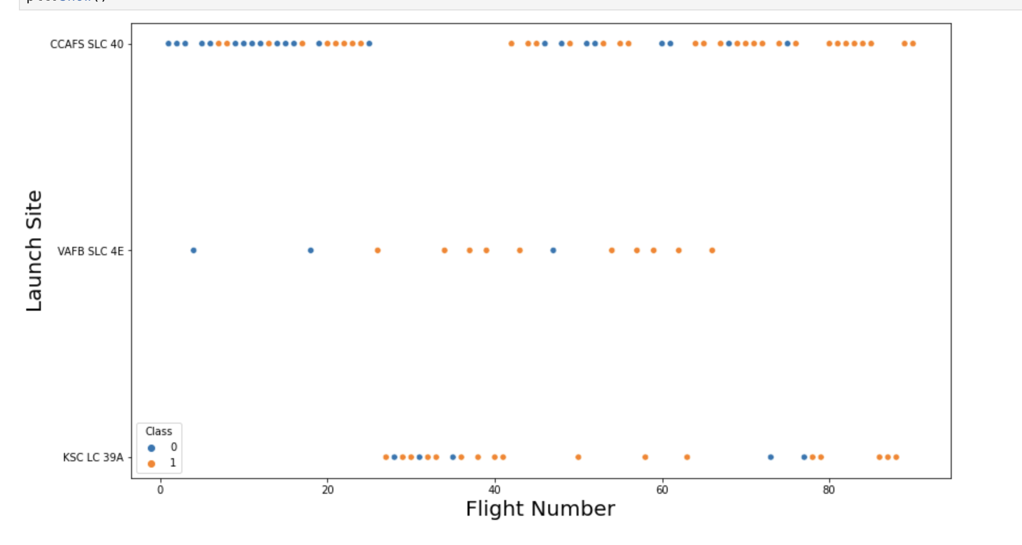
Flight Number vs. Launch Site
From the plot, we found that the larger the flight amount at a launch site, the greater the success rate at a launch site.

Slide 19
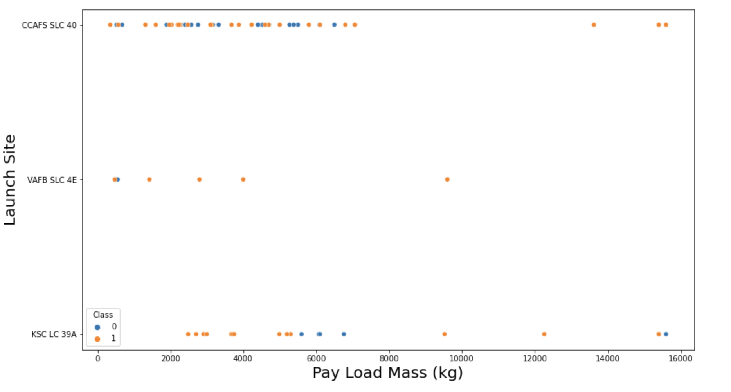
Payload vs. Launch Site
The greater the payload mass for launches at CCAFS SLC 40, the higher the success rate of the rocket.

Slide 20
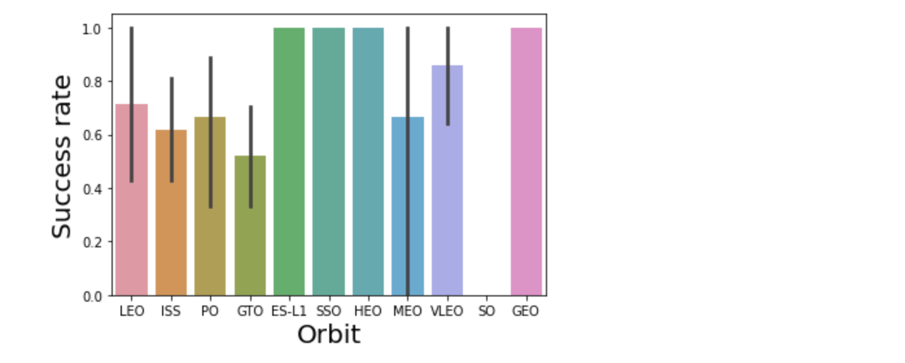
Success Rate vs. Orbit Type
The relationship between success rate and orbit type
VLEO had the most success rate.

Slide 21
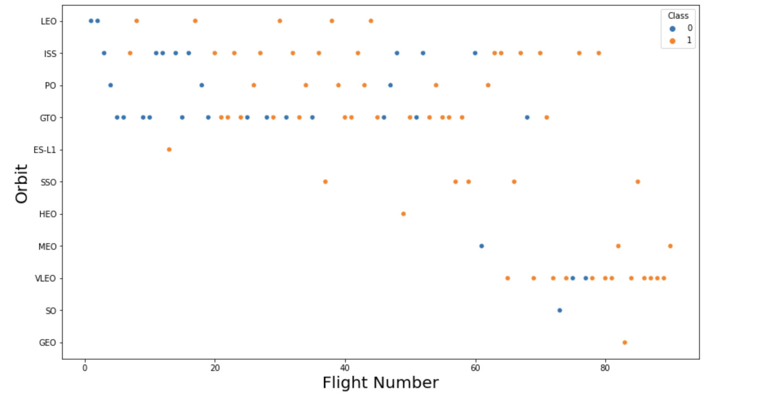
Flight Number vs. Orbit Type
The plot below shows the Flight Number vs. Orbit type. We observe that in the LEO orbit, success is related to the number of flights whereas in the GTO orbit, there is no relationship between flight number and the orbit.

Slide 22
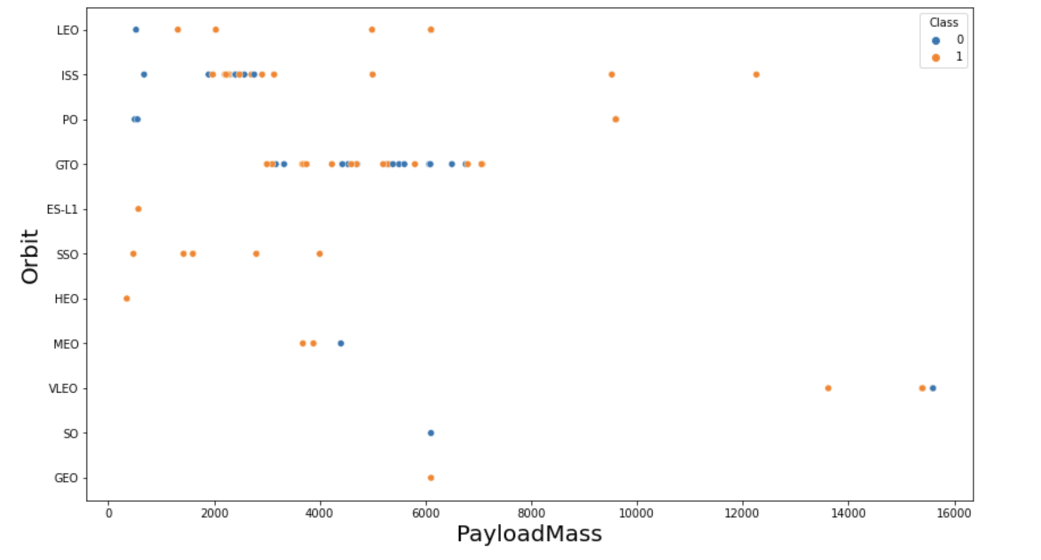
Payload vs. Orbit Type
We can observe that with heavy payloads, the successful landing are more for PO, LEO and ISS orbits.20

Slide 23
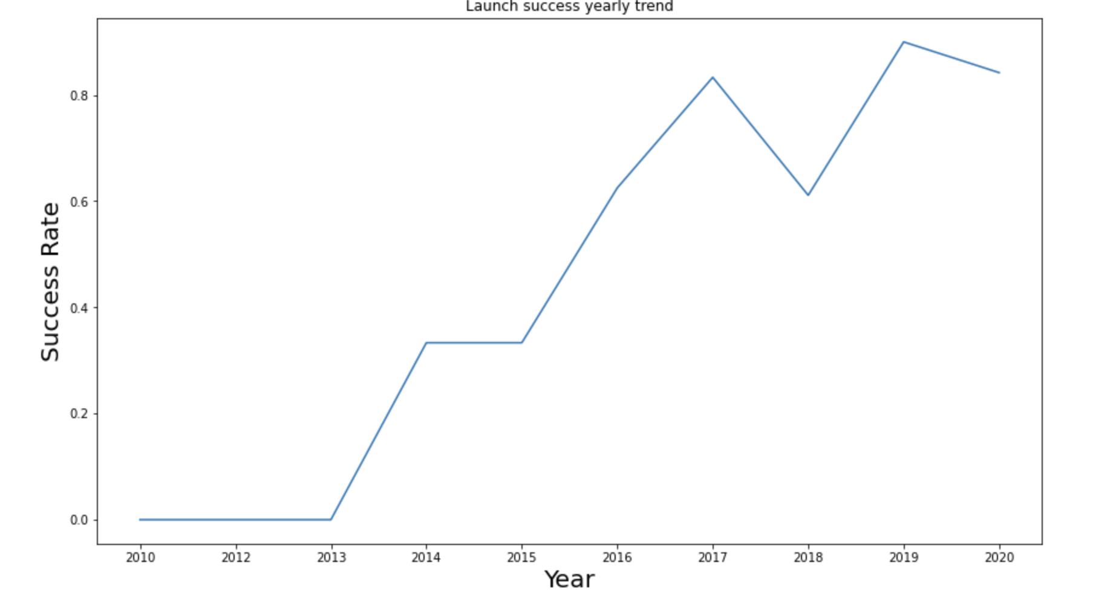
Launch Success Yearly Trend
From the plot, we can observe that success rate since 2013 kept on increasing till 2020

Slide 24
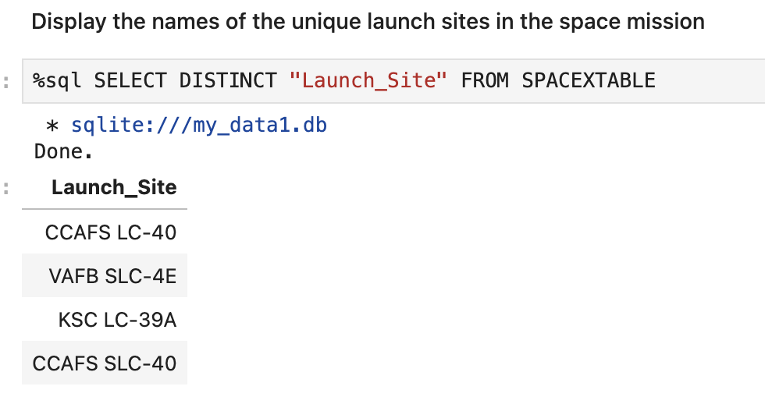
All Launch Site Names
We used the key word DISTINCT to show only unique launch sites from the SpaceX data.

Slide 25
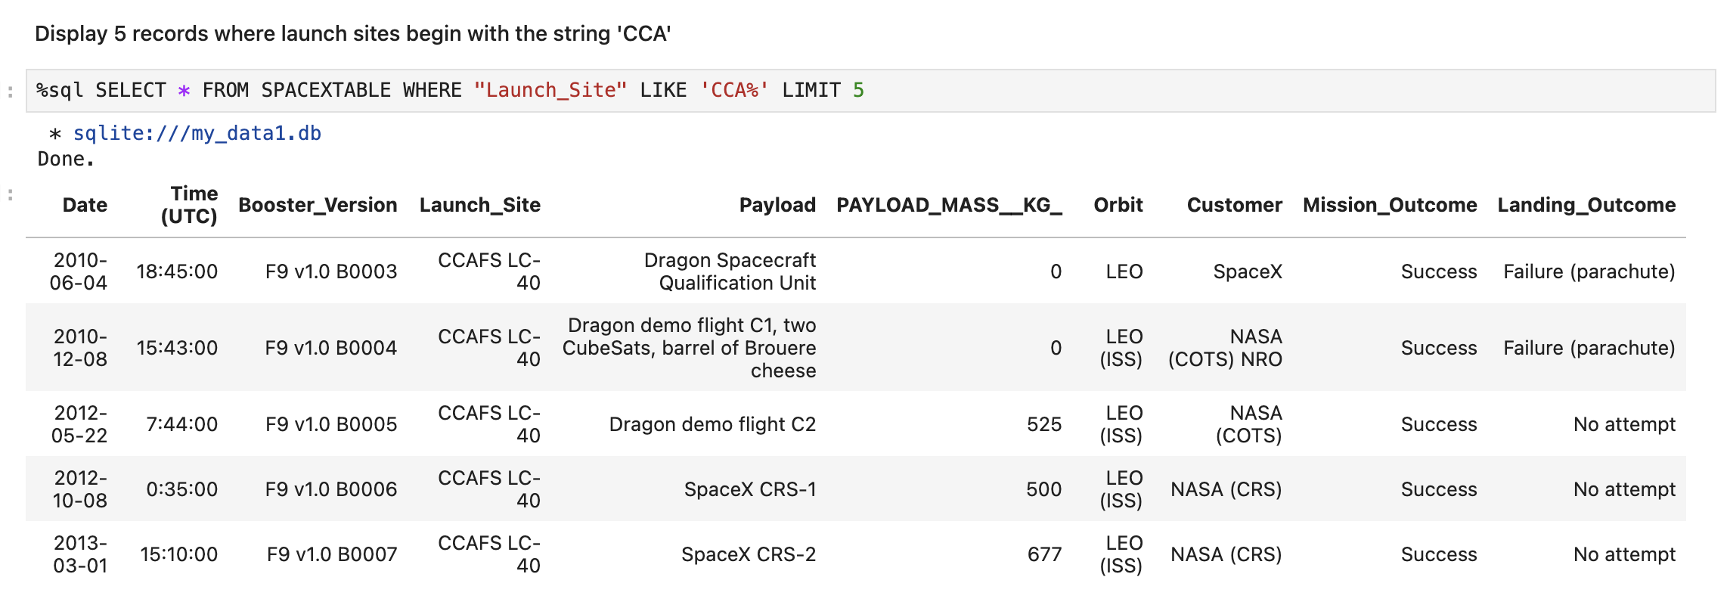
Launch Site Names Begin with 'CCA'
This SQL query retrieves the first 5 records from the SPACETABLE where the Launch_Site starts with "CCA". It displays details like the launch date, payload mass, orbit type, and mission outcome.

Slide 26
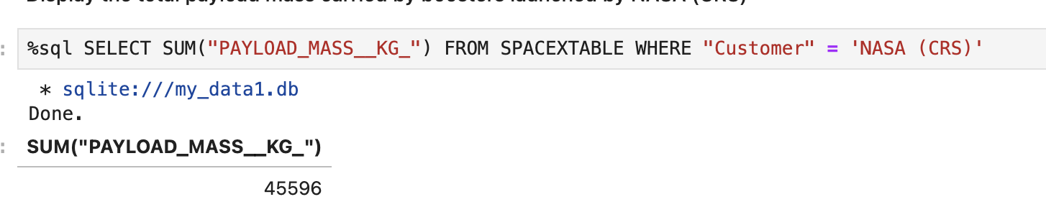
Total Payload Mass
This SQL query calculates the total payload mass carried by boosters launched for NASA (CRS). The result of the query is 45,596 KG, representing the sum of the payload mass for all such launches.

Slide 27
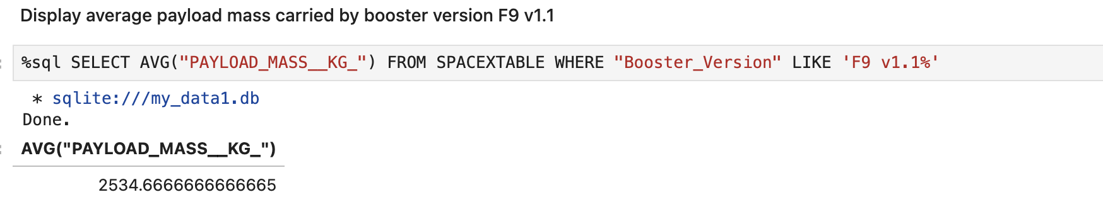
Average Payload Mass by F9 v1.1
Calculate the average payload mass carried by booster version F9 v1.1

Slide 28
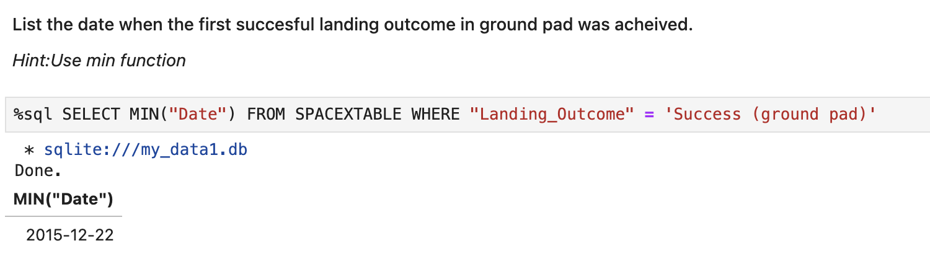
First Successful Ground Landing Date
Find the dates of the first successful landing outcome on ground pad

Slide 29
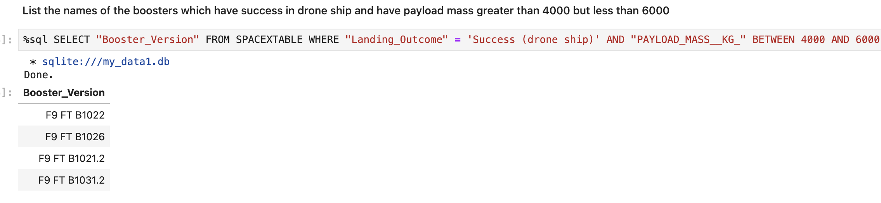
Successful Drone Ship Landing with Payload between 4000 and 6000
List the names of boosters which have successfully landed on drone ship and had payload mass greater than 4000 but less than 6000

Slide 30
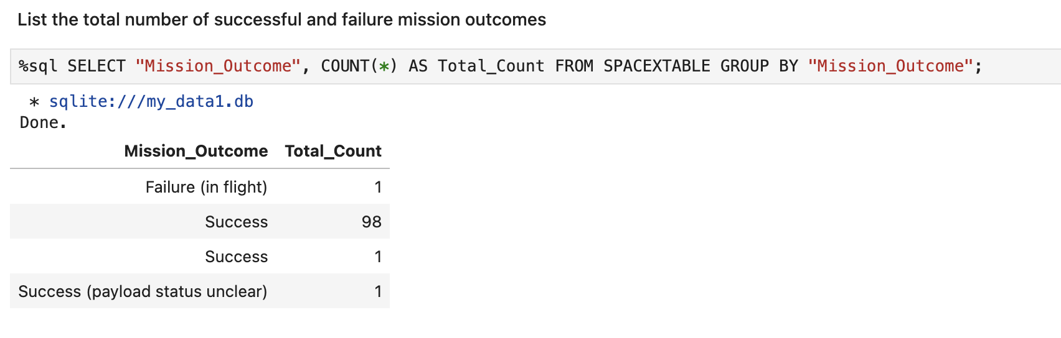
Total Number of Successful and Failure Mission Outcomes
Calculate the total number of successful and failure mission outcomes

Slide 31
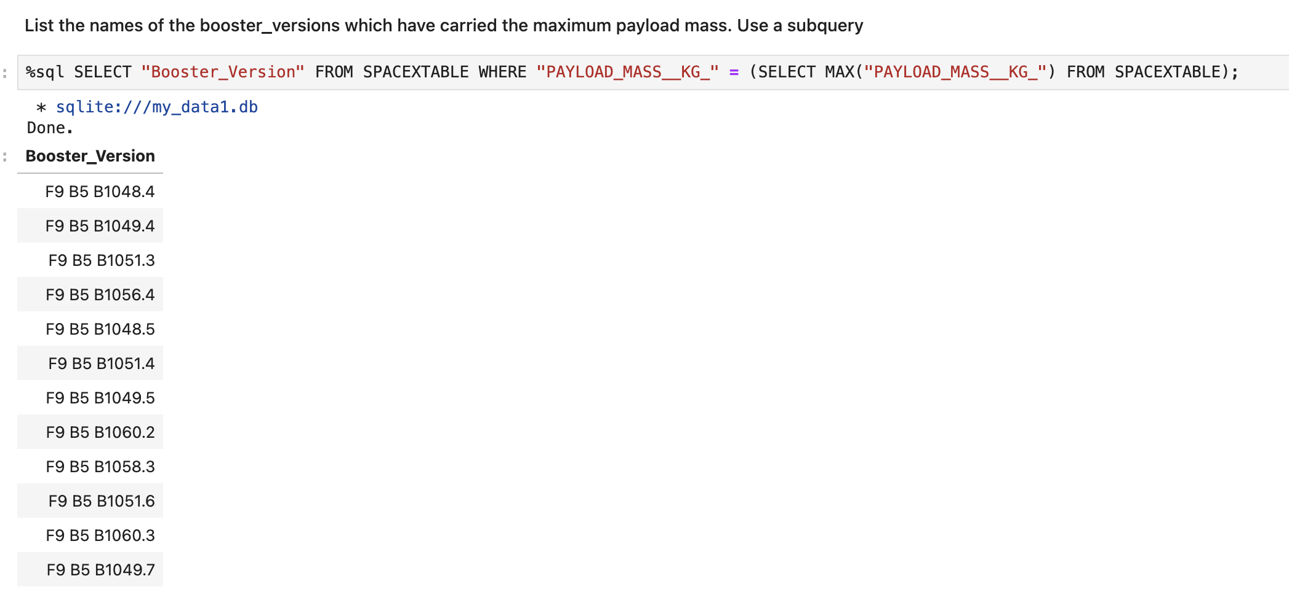
Boosters Carried Maximum Payload
List the names of the booster which have carried the maximum payload mass

Slide 32
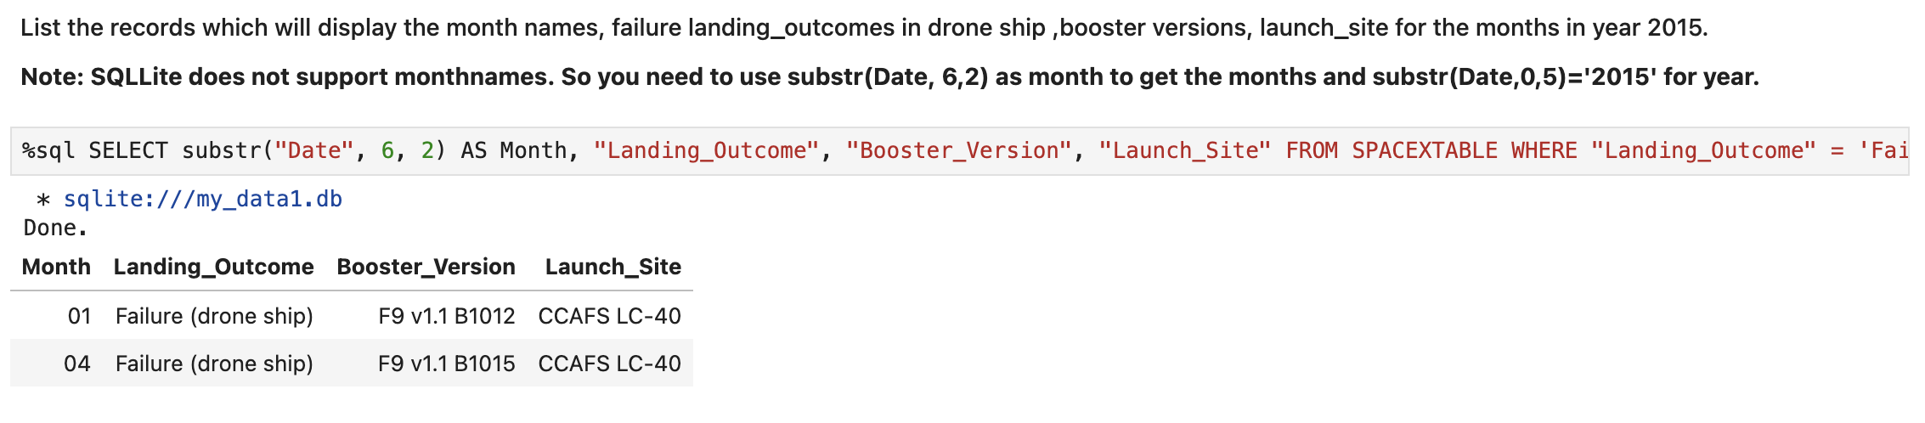
2015 Launch Records
List the failed landing_outcomes in drone ship, their booster versions, and launch site names for in year 2015

Slide 33
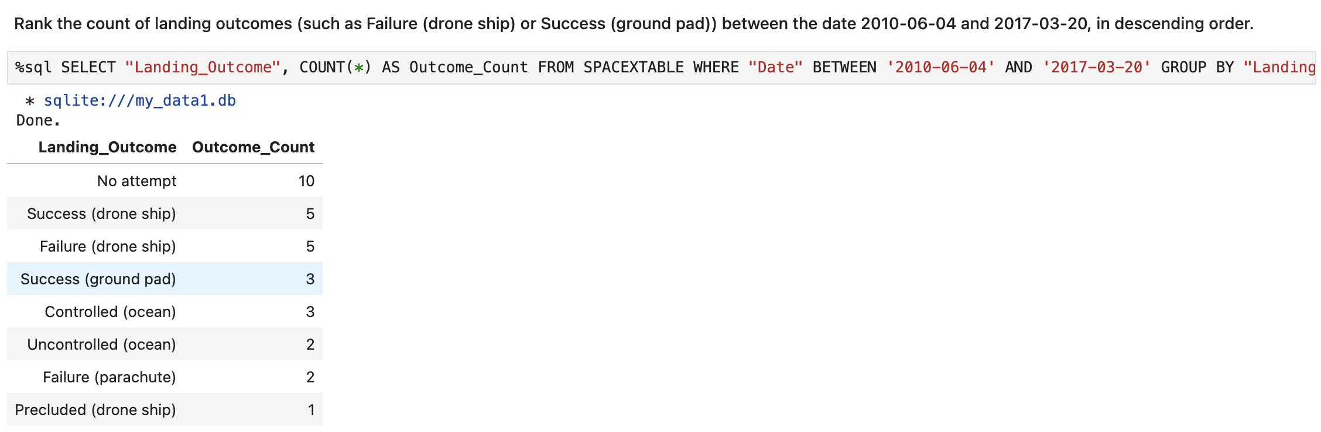
Rank Landing Outcomes Between 2010-06-04 and 2017-03-20
Rank the count of landing outcomes (such as Failure (drone ship) or Success (ground pad)) between the date 2010-06-04 and 2017-03-20, in descending order

Slide 34

Section 3

Slide 35
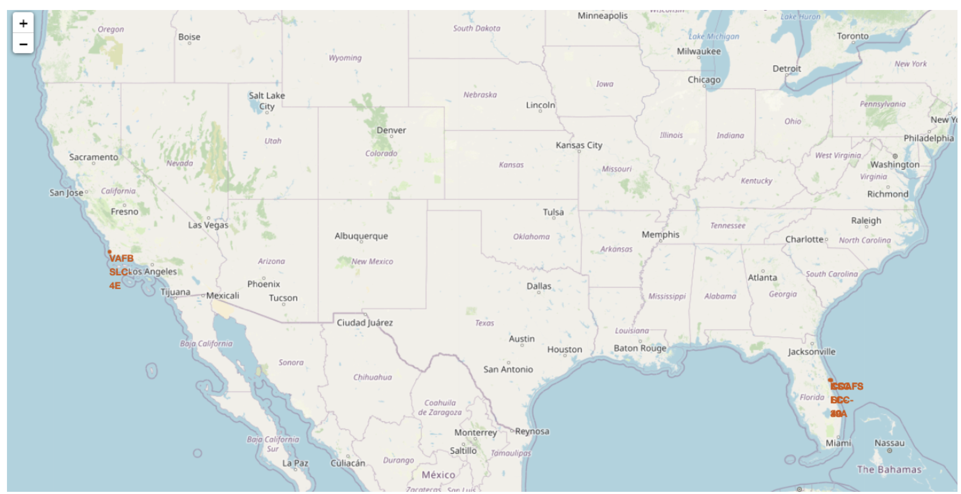
All launch sites
All launch sites on map

Slide 36
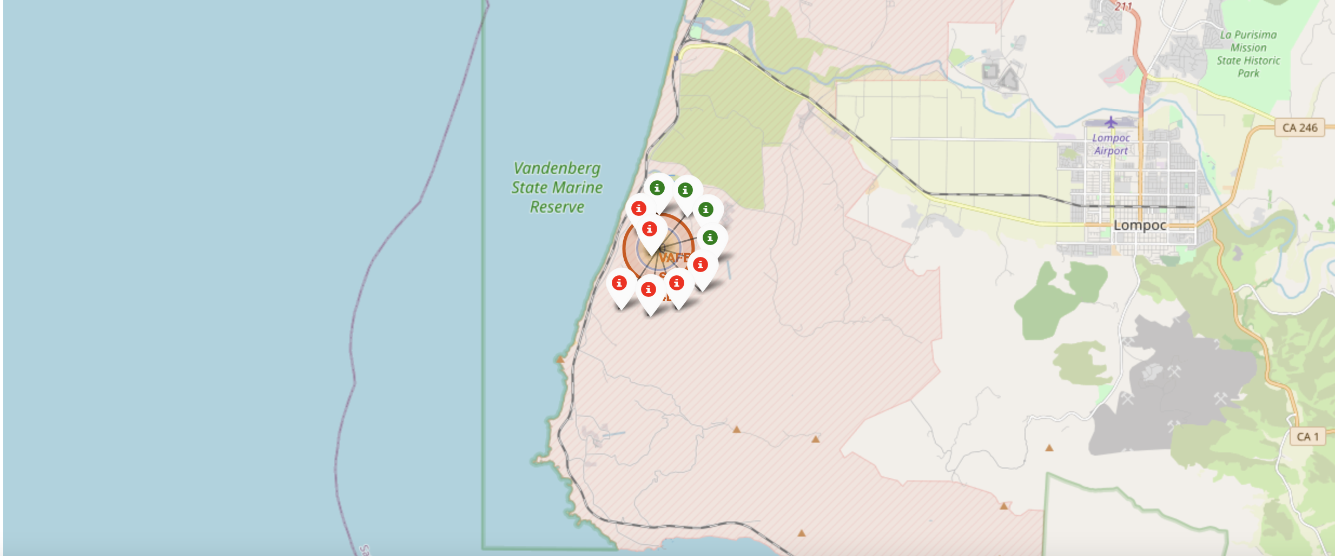
The succeeded launches and failed launches
The succeeded launches and failed launches for each site on map
If we zoom in on one of the launch site, we can see green and red tags. Each green tag represents a successful launch while each red tag represents a failed launch

Slide 37
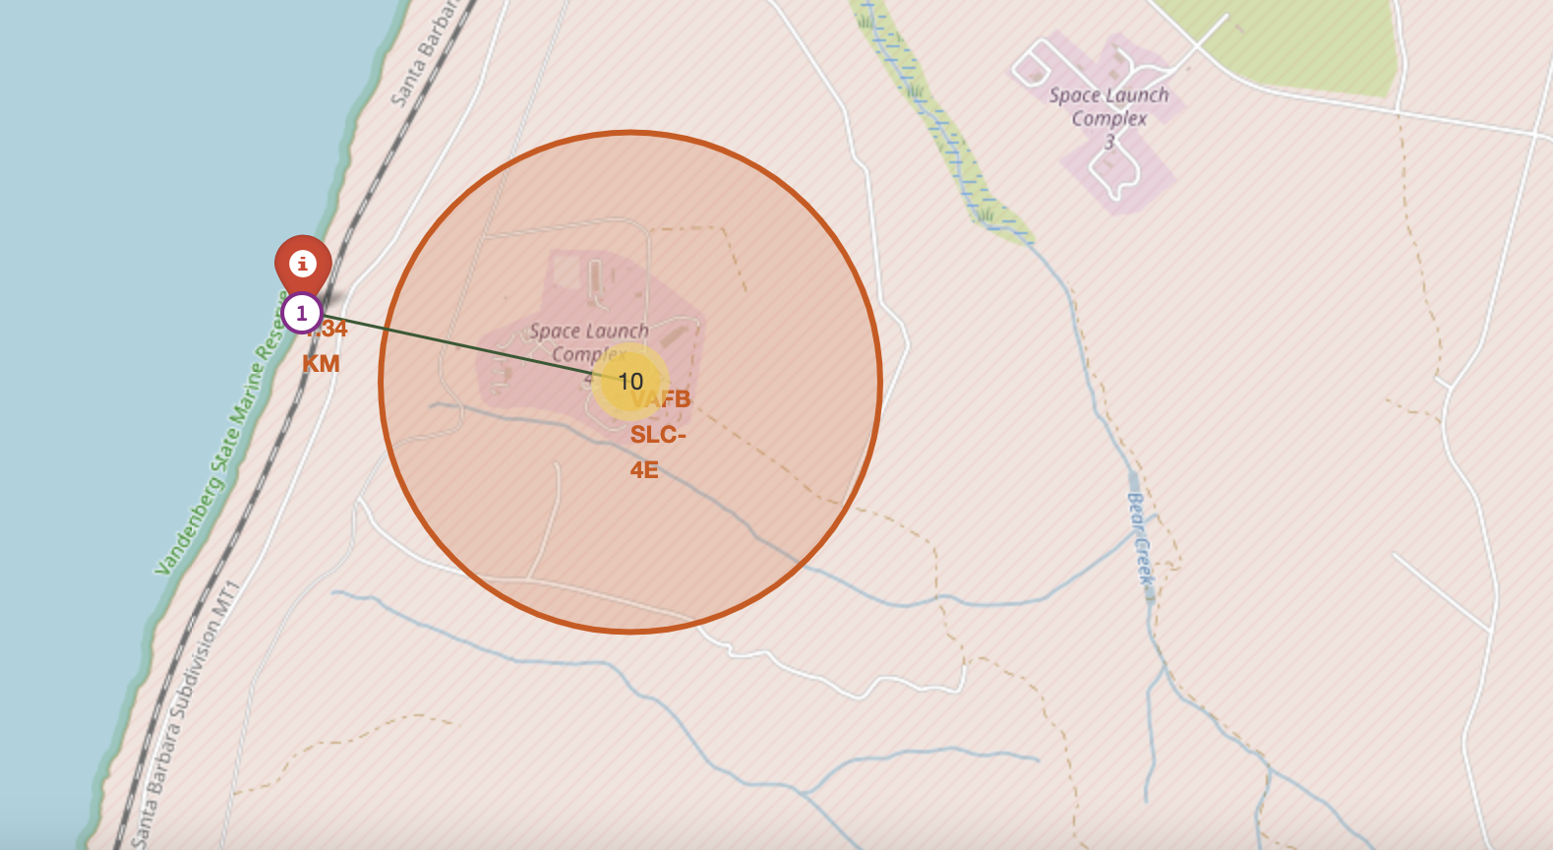
The distance
The distances between a launch site to its proximities such as the nearest city, railway, or highway
The picture below shows the distance between the VAFB SLC-4E launch site and the nearest coastline

Slide 38

Section 4

Slide 39

Dashboard
The picture below shows a pie chart when launch site CCAFS LC-40 is chosen.
0 represents failed launches while 1 represents successful launches. We can see that 73.1% of launches done at CCAFS LC-40 are failed launches.

Slide 40
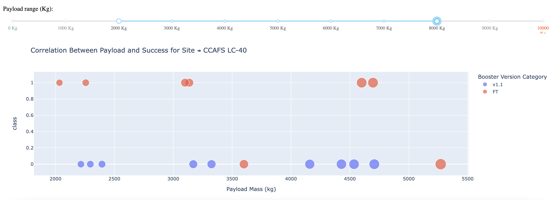
Dashboard
The picture below shows a scatterplot when the payload mass range is set to be from 2000kg to 8000kg.
Class 0 represents failed launches while class 1 represents successful launches.

Slide 41

Section 5

Slide 42

Classification Accuracy
The decision tree classifier is the model with the highest classification accuracy

Slide 43

Confusion Matrix
The confusion matrix for the decision tree classifier shows that the classifier can distinguish between the different classes. The major problem is the false positives .i.e., unsuccessful landing marked as successful landing by the classifier.

Slide 44
Conclusions
Project Goal: Predict if the first stage of a Falcon 9 launch will land to determine the cost of a launch.
Features: Key features like payload mass and orbit type influence the mission outcome.
Machine Learning Models: Several machine learning algorithms are used to analyze past launch data and build predictive models.
Best Performing Model: The Decision Tree algorithm outperformed the other 3 models in predicting launch outcomes.

Slide 45


